Slide 1
Graphs: Minimum Spanning Tree(MST)

Slide 2
Problem: Laying Telephone Wire
Wiring: Naïve Approach
Central office
Expensive!

Slide 3
Wiring: Better Approach
Central office
Minimize the total length of wire connecting the customers

Slide 4
Minimum Spanning Tree (MST)
A minimum spanning tree is a subgraph of an undirected weighted graph G, such that
it is a tree (i.e., it is acyclic)
it covers all the vertices V
  contains |V| - 1 edges
the total cost associated with tree edges is the minimum among all possible spanning trees
not necessarily unique

Slide 5
Applications of MST
Any time you want to visit all vertices in a graph at minimum cost (e.g., wire routing on printed circuit boards, sewer pipe layout, road planning…)

Slide 6
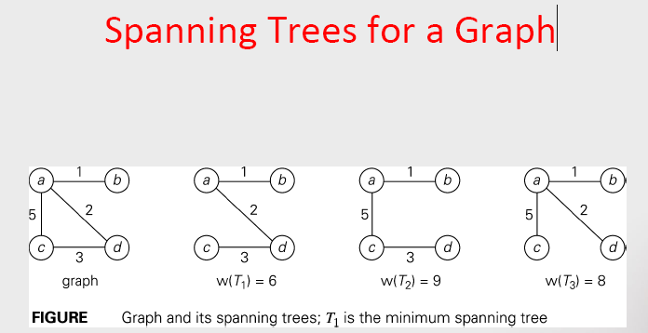
MST example

Slide 7
How Can We Generate a MST?
(May use any one algorithm)
9
b
9
b
a
2
6
a
2
6
d
d
4
5
4
5
5
4
5
4
5
e
5
e
c
c

Slide 8
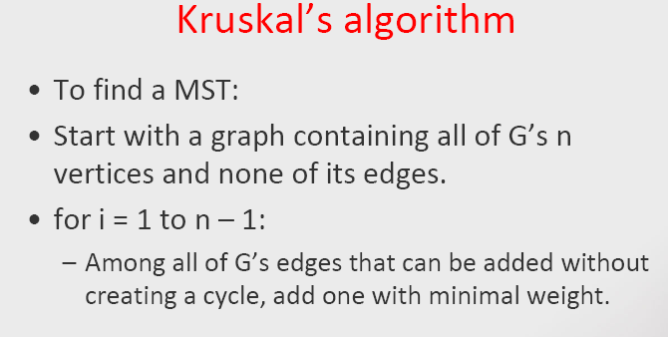

Slide 9
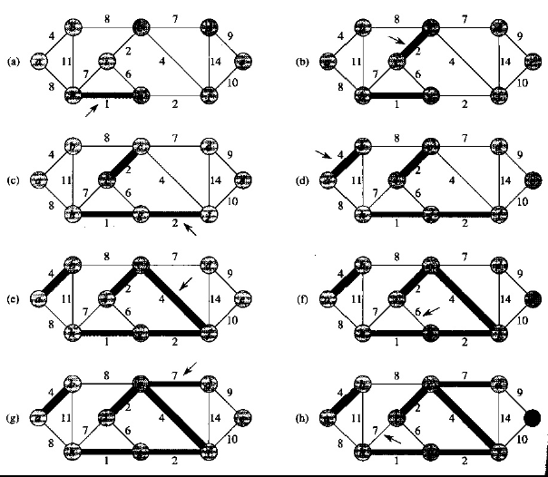

Slide 10
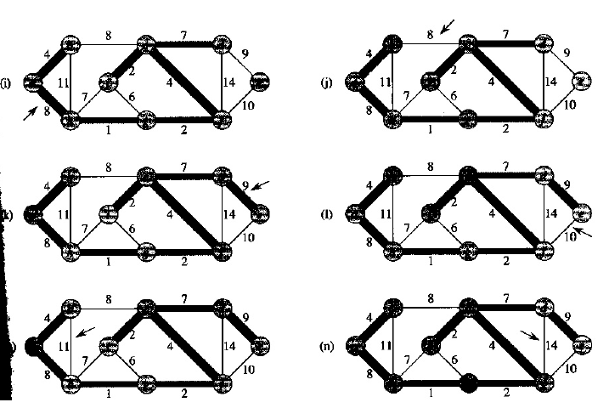

Slide 11
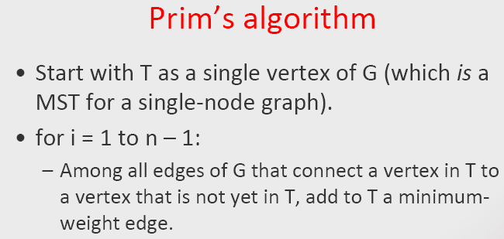

Slide 12
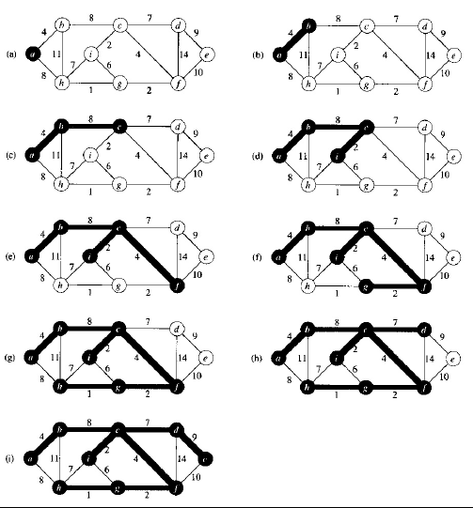

Slide 13
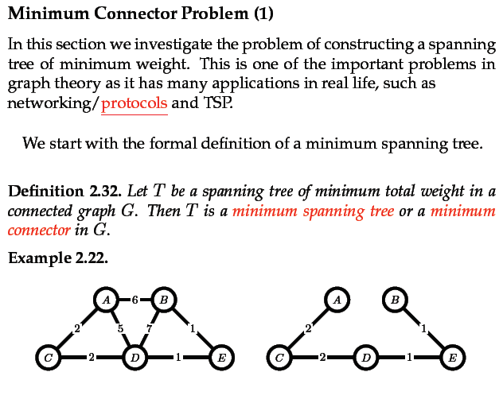

Slide 14
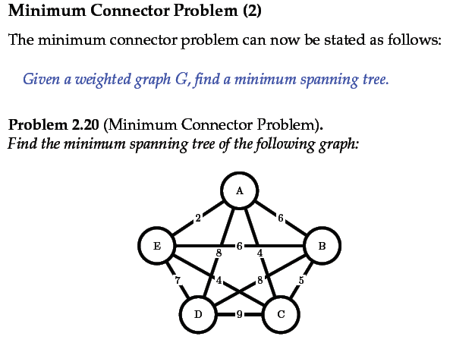

Slide 15
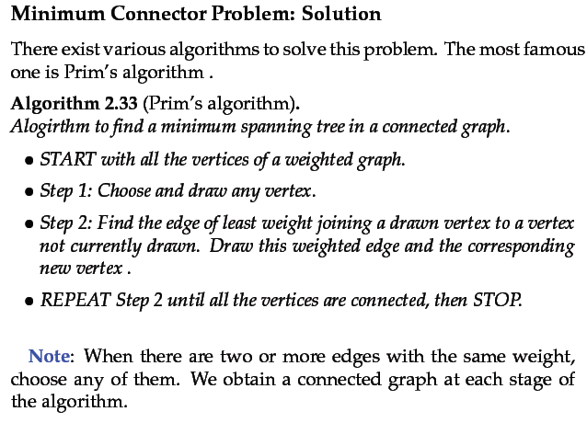

Slide 16
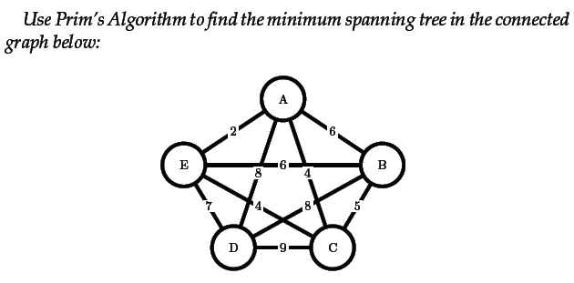
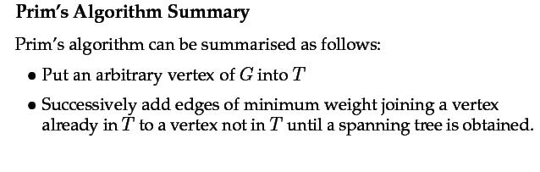

Slide 17
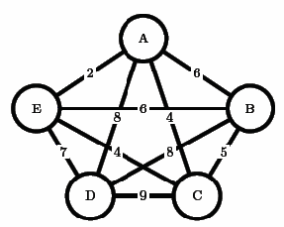
A greedy algorithm: involves choosing edges of minimum weight and in such a way that no cycle is created.
Choose AB (2); BD(3); cant choose AD (4), , since it would create cycle.
Chose DE(5)……….
Finaly, complete tree with edges AB,BC,BD,DE

